Slide 1
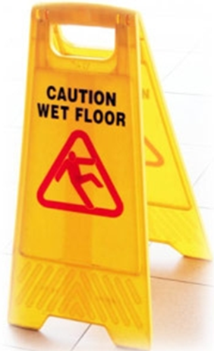
Medical Equipment Performance and Safety
  Clinical effectiveness vs. performance
  Life span of medical equipment
17.1.2 Relate Medical Equipment Performance to Safety
Unit C 17.1 Medical Equipment Safety
Module 279-17-C Regulations, Standards and Ethics
©
dr. Chris R. Mol, BME, NORTEC, 2017

Slide 2
Clinical effectiveness vs. performance
A device is Clinically Effective when it produces the effect intended by the manufacturer relative to the medical condition.
For example, if a device is intended for pain relief, it is clinically effective if it actually relieves pain.
Clinical effectiveness is a good indicator of device performance
(i.e. normally, if the device is effective, it is also performing well)
But: for a device to demonstrate a good performance it is not enough to be clinically effective:
also other technical features need to function/perform well.
For example, an alarm feature may not directly contribute to clinical effectiveness but may be necessary for good performance.
Performance (does the device function as intended) is easier to measure than clinical effectiveness.
That’s why most Regulation refers to Performance, rather than Clinical Effectivity!
©
Medical Equipment Performance and Safety
dr. Chris R. Mol, BME, NORTEC, 2017

Slide 3
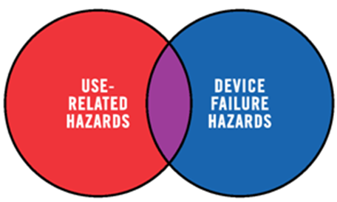
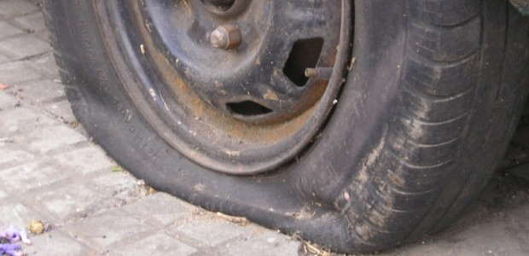
Safety is closely aligned with device performance
Risks are often associated with non-performance of a device
i.e.
risk occurs often when a device is malfunctioning
A car is effective when it can drive, but it is dangerous
if its tires are worn or its lights malfunctions
Driving is always dangerous, but it gets especially dangerous when the car breaks down
For example, a patient monitor that does not perform well can pose serious clinical safety problems to the patient.
Thus, the safety and performance of medical devices are normally considered together.
©
Concepts of Safety and Risk Management
dr. Chris R. Mol, BME, NORTEC, 2017

Slide 4
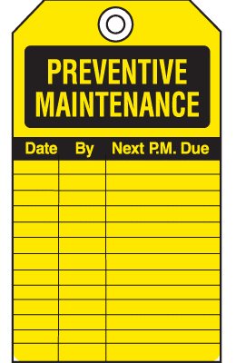
Safety, performance and preventive maintenance
      During preventive maintenance of medical equipment we check:
          equipment performance as specified (check use !)
          technical parameters (electrical safety, …)
          wearing and tearing
          …
          Much like the annual car ‘road testing’
Preventive Maintenance is important for improving Safety!
©
Concepts of Safety and Risk Management
dr. Chris R. Mol, BME, NORTEC, 2017

Slide 5
Annual RDSA ‘Preventive Maintenance’ test form
©
Concepts of Safety and Risk Management
dr. Chris R. Mol, BME, NORTEC, 2017

Slide 6
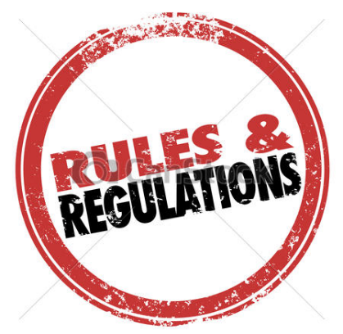
A device needs to be safe always, not only just after installation....
Safety throughout the life cycle
Therefore, there are regulations for all phases
throughout the equipment life cycle
©
Concepts of Safety and Risk Management
dr. Chris R. Mol, BME, NORTEC, 2017

Slide 7
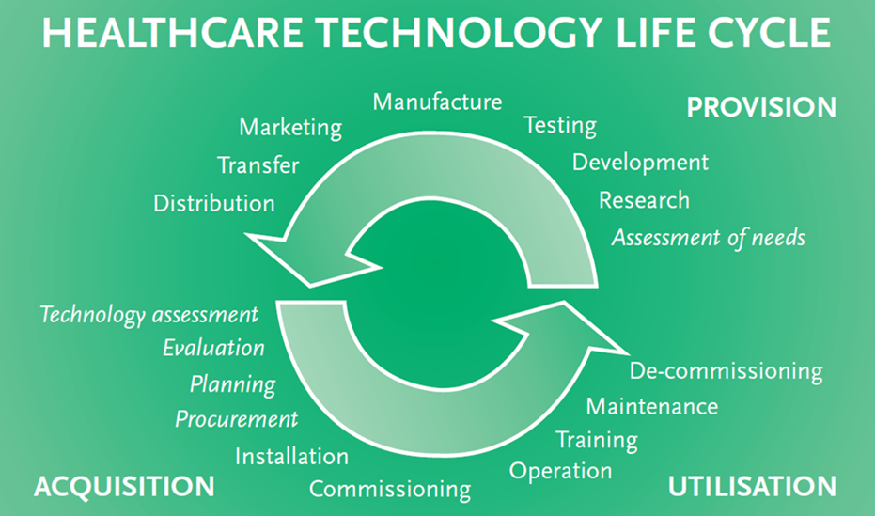
Life span of Medical Equipment: Extended
supplier / manufacturer
user / hospital
©
Medical Equipment Performance and Safety
dr. Chris R. Mol, BME, NORTEC, 2017

Slide 8
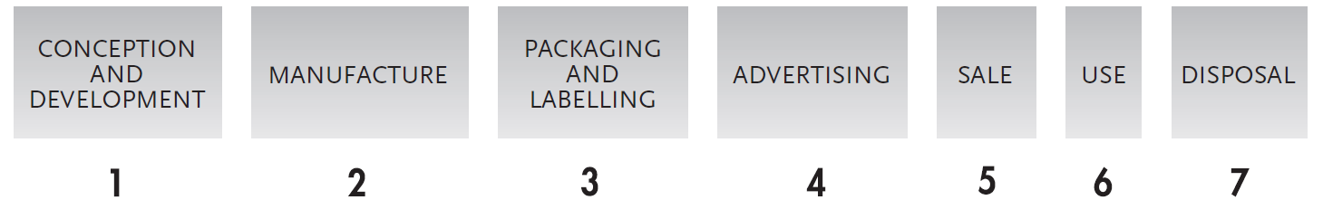
Major phases in the life cycle of medical equipment
This diagram is simplified to make it easier to understand the regulatory system.
For example, in reality the development phase can be subdivided in development planning, design verification/validation, prototype testing and clinical trials.
In practice, the various phases overlap and interact.
All of these phases can affect the safety and performance of a medical device,
and therefore all phases are regulated!
©
Medical Equipment Performance and Safety
dr. Chris R. Mol, BME, NORTEC, 2017

Slide 9
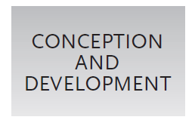
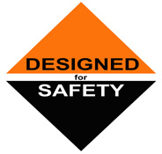
Conception and development
The scientific principles upon which a device is based are fundamental to its safety and performance.
For example, a cardiac pacemaker should deliver a small electrical impulse of a certain size and shape that simulates the natural functioning of the heart. Significant deviation from this may compromise safety and performance.
The more complex the device, the higher the risk of user error. Soundness of concept and adequacy of design, construction, and testing (including verification, validation and clinical trials) require the scrutiny of scientific experts to ensure that design parameters and performance characteristics do not impose unwarranted risks.
©
Participants in Safety
dr. Chris R. Mol, BME, NORTEC, 2017

Slide 10
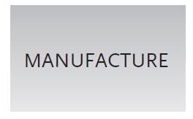
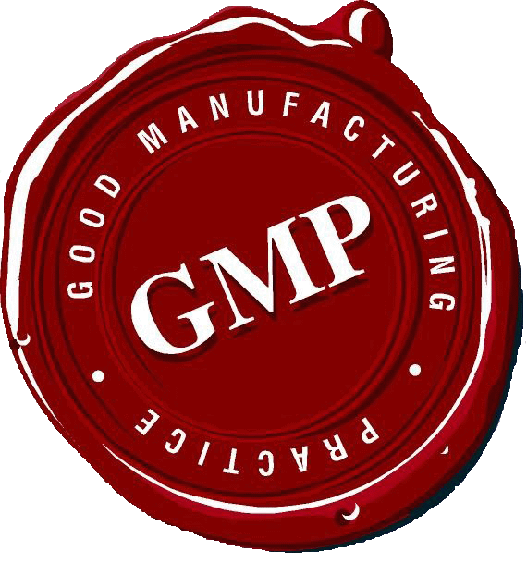
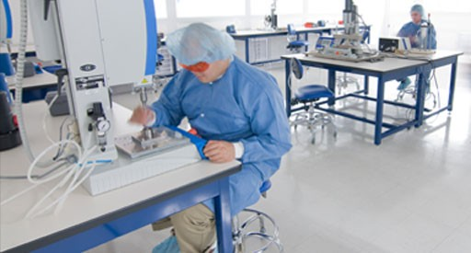
Manufacture
Good, functional medical devices are only produced when the manufacturing process is adequately managed.
Poor manufacturing management can produce inconsistency in the quality of products, such that non-conforming devices can filter through the production line to the market, even when the original prototype has been well-designed.
This consideration has led to the development of Good Manufacturing Practice (GMP) for drugs, biological products and medical devices. GMP is more commonly referred to as “quality systems in manufacturing”.
©
Participants in Safety
dr. Chris R. Mol, BME, NORTEC, 2017

Slide 11
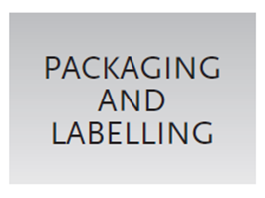
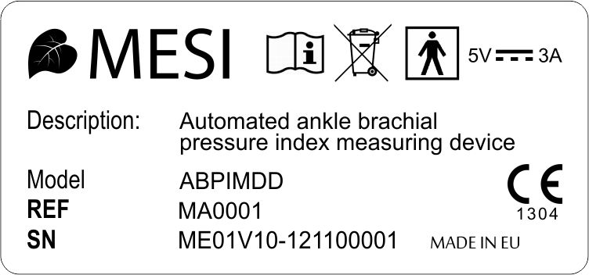
Package and labelling
It is important that well-designed packaging systems deliver clean, sterile and protected medical devices to the point of use. Properly packaged medical devices are safe to handle, even if the medical device is biohazardous.
Shipping is one of the hazards that a medical device and its packaging must survive. Subtle damage can result during transportation and handling unless the total packaging system is designed robustly and can withstand various stresses. Well-sealed packaging is essential for those medical devices that must be maintained sterile.
Labelling is crucial in identifying the medical device and specifying instructions for its proper use. As for drugs, mislabelling of medical devices can result in serious consequences for the user. Hazard warnings or cautions and clear instructions for use are very important.
©
Participants in Safety
dr. Chris R. Mol, BME, NORTEC, 2017

Slide 12
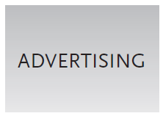

Advertising
Advertisement has the potential to create expectations and to strongly influence the belief in a medical device’s capabilities.
Therefore, medical device marketing and advertising must be regulated to prevent misrepresentation of a medical device and its performance.
Misleading or fraudulent advertising of medical devices may increase sales. However, from the buyer’s perspective, the purchase of an inappropriate medical device is a waste of money that may deprive the patient of more appropriate treatment and could lead to patient or user injury.
©
Participants in Safety
dr. Chris R. Mol, BME, NORTEC, 2017

Slide 13


Sale
The sale of medical devices by the vendor is a critical stage that leads to the device being put into actual use.
If the vendor is not subject to regulation, then there is higher risk of exposing the public to low quality or ineffective devices.
©
Participants in Safety
dr. Chris R. Mol, BME, NORTEC, 2017

Slide 14
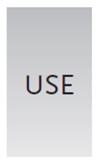
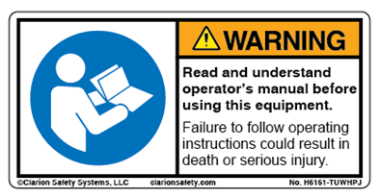
Use
Users of medical devices can have a profound effect on their safety and effective performance. Unfamiliarity with a certain technology or operating procedure, and the use of products for clinical indications outside the scope of those specified in the labelling, can cause device failure even in the absence of any inherent design or manufacturing defects.
Within the clinical engineering community it is widely believed that user error underlies at least half of all medical device-related injuries and deaths.
The re-use of disposable devices contrary to the manufacturers instructions, and without proper control or precautions for minimizing associated risks, can be dangerous.
The lack of, or inappropriate, calibration and maintenance of medical devices can seriously jeopardize their safety and performance.
©
Participants in Safety
dr. Chris R. Mol, BME, NORTEC, 2017

Slide 15
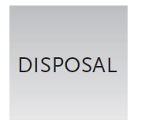
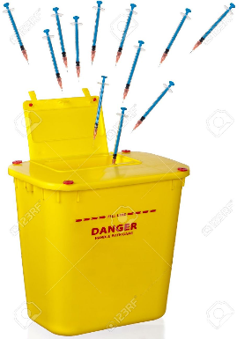
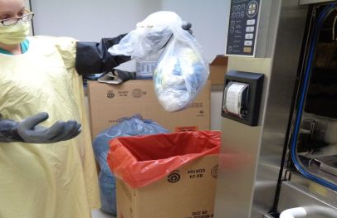
Disposal
Disposal of certain types of devices should follow specific and stringent safety rules.
For example, devices that are contaminated after use (e.g. syringes) or devices that contain toxic chemicals, can present hazards to people or the environment and must be disposed of properly.
©
Participants in Safety
dr. Chris R. Mol, BME, NORTEC, 2017

Slide 16

Many people are involved in medical equipment safety
It is people who manage each phase in the life span of a medical device, and these people should be identified and called on to participate in ensuring medical device safety.
This is the topic of the next lecture…..
©
Participants in Safety
dr. Chris R. Mol, BME, NORTEC, 2017

Slide 17

END
The creation of this presentation was supported by a grant from THET:
see https://www.thet.org/

